Slide 1
CRACKING BASE64 ENCRYPTION
USING base64 UTILITY

Slide 2
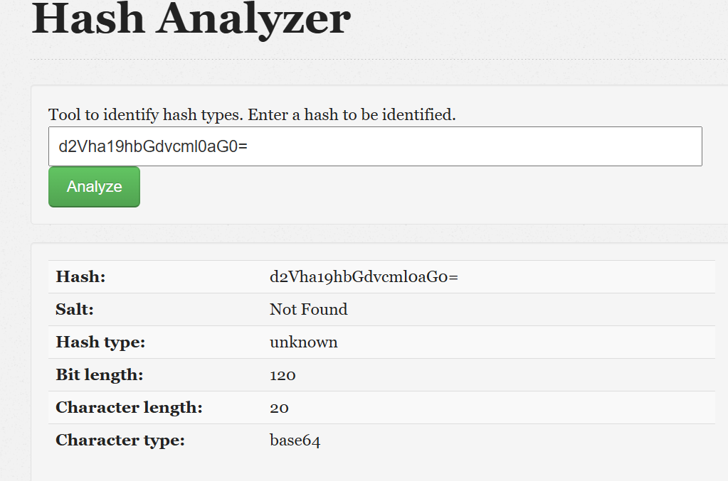
CHECKING THE FORMAT

Slide 3

As you can see I used the base64 utility. The base64 cmd helps to encrypt and decrypt in that specific format. For further study you can checkout the algorithm online.
Base64 –d (the –d is used for decoding the encrypted gibberish format). As you can see after decoding we get the “weak_ algorithm” string.

